Slide 1


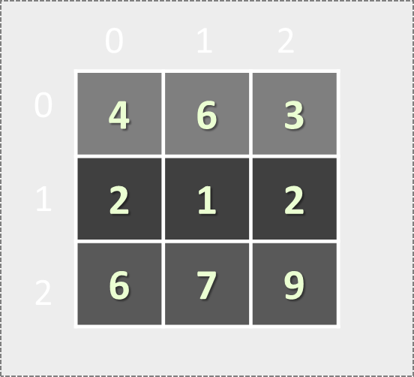

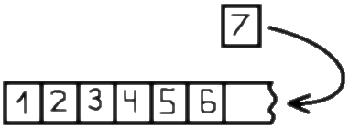
Lists and Matrices
Lists: Variable-Size Arrays
Matrices: Arrays of Arrays (Tables)
Lists and Matrices
SoftUni Team
Technical Trainers
Software University
http://softuni.bg

Slide 2


Table of Contents
Lists and the List<T> Type
Variable-Size Arrays
Sorting Lists and Arrays
Lists – Problems
Multi-Dimensional Arrays
Matrices: Reading, Printing and Processing
Matrices – Problems

Slide 3
Lists of Elements
Variable-Size Arrays: List<T>

Slide 4

Lists
In C# arrays have fixed length
Cannot add / remove / insert elements
Lists are like resizable arrays
Support add / remove / insert of elements
List<T> defines a list of certain type T
T is the type of the list, e.g. string, int, DateTime, …
List<int> numbers = new List<int>();
numbers.Add(5);
Console.WriteLine(numbers[0]); // 5

Slide 5
List<T> – Example
Use System.Collections.Generic to access collection classes like List<T>
using System.Collections.Generic;
…
List<string> names = new List<string>() { "Peter",
"Maria", "Katya", "Todor" }; // Peter, Maria, Katya, Todor
names.Add("Nakov"); // Peter, Maria, Katya, Todor, Nakov
names.RemoveAt(0); // Maria, Katya, Todor, Nakov
names.Remove("Todor"); // Maria, Katya, Nakov
names.Insert(2, "Sylvia"); // Maria, Katya, Sylvia, Nakov
names[1] = "Michael"; // Maria, Michael, Sylvia, Nakov
foreach (var name in names)
Console.WriteLine(name);

Slide 6
Problem: Remove Negatives and Reverse
Read a list of integers, remove all negative numbers from it and print the list in reversed order:
10 -5 7 9 -33 50
50 9 7 10
7 -2 -10 1
1 7
1 2 3
3 2 1
-1 -2 -3
empty
Check your solution here: https://judge.softuni.bg/Contests/Practice/Index/173#0

Slide 7
Solution: Remove Negatives and Reverse
using System.Collections.Generic;
using System.Linq;
…
List<int> list = Console.ReadLine()
.Split(' ').Select(int.Parse).ToList();
List<int> result = new List<int>();
foreach (var item in list)
if (item >= 0) result.Add(item);
result.Reverse();
if (result.Count > 0)
Console.WriteLine(string.Join(" ", result));
else Console.WriteLine("empty");
Read a list from the console
Check your solution here: https://judge.softuni.bg/Contests/Practice/Index/173#0

Slide 8
Problem: Append Lists
Write a program to append several lists of numbers
Lists are separated by |
Values are separated by spaces (one or several)
Order the lists from last to first, and their values from left to right
1 2 3 |4 5 6 | 7 8
7 8 4 5 6 1 2 3
7 | 4 5|1 0| 2 5 |3
3 2 5 1 0 4 5 7
1| 4 5 6 7 | 8 9
8 9 4 5 6 7 1
Check your solution here: https://judge.softuni.bg/Contests/Practice/Index/173#1

Slide 9
Solution: Append Lists
var lists = Console.ReadLine().Split('|');
var result = new List<string>();
for (int i = lists.Length - 1; i >= 0; i--)
{
var list = lists[i].Split(' ');
foreach (var item in list)
result.Add(item);
// TODO: skip empty items
}
Console.WriteLine(string.Join(" ", result));
Check your solution here: https://judge.softuni.bg/Contests/Practice/Index/173#1

Slide 10
Problem: Sum Adjacent Equal Numbers
Write a program to sum all adjacent equal numbers in a list of decimal numbers, starting from left to right
After two numbers are summed, the obtained result could be equal to some of its neighbors and should be summed as well
3 3 6 1
6 6 1
12 1
0.1 0.1 5 -5
0.2 5 -5
8 2 2 4 8 16
8 4 4 8 16
8 8 8 16
16 8 16
5 4 2 1 1 4
5 4 2 2 4
5 4 4 4
5 8 4
Check your solution here: https://judge.softuni.bg/Contests/Practice/Index/173#2

Slide 11
Solution: Sum Adjacent Equal Numbers
var nums = Console.ReadLine().Split(' ')
.Select(double.Parse).ToList();
int pos = 0;
while (pos < nums.Count - 1)
if (nums[pos] == nums[pos + 1])
{
nums.RemoveAt(pos);
nums[pos] = 2 * nums[pos];
pos--; // TODO: ensure the position is non-negative
}
else pos++;
Console.WriteLine(string.Join(" ", nums));
Replace equal adjacent numbers with their sum; move one position back
Check your solution here: https://judge.softuni.bg/Contests/Practice/Index/173#2

Slide 12
Problem: Split by Word Casing
Read a text, split it into words and distribute them into 3 lists:
Lower-case words; mixed-case words; upper-case words
Use the following separators: , ; : . ! ( ) " ' / \ [ ] space
Learn programming at SoftUni: Java, PHP, JS, HTML 5, CSS, Web, C#, SQL, databases, AJAX, etc.
Non-letters are considered mixed-case
Lower-case: programming, at, databases, etc
Mixed-case: Learn, SoftUni, Java, 5, Web, C#
Upper-case: PHP, JS, HTML, CSS, SQL, AJAX
Check your solution here: https://judge.softuni.bg/Contests/Practice/Index/173#3

Slide 13
Solution: Split by Word Casing
var separators new char[]
{ ',', ';', ':', '.', '!', ' ' };
var words = Console.ReadLine().Split(separators,
StringSplitOptions.RemoveEmptyEntries).ToList();
var lowerCaseWords = new List<string>();
var mixedCaseWords = new List<string>();
var upperCaseWords = new List<string>();
foreach (var word in words)
{ // TODO: process each word }
Console.WriteLine("Lower-case: {0}",
string.Join(", ", lowerCaseWords));
// TODO: print the other lists
Check your solution here: https://judge.softuni.bg/Contests/Practice/Index/173#3

Slide 14
Solution: Split by Word Casing (2)
// Process each word
var lowerCaseChars = 0;
var upperCaseChars = 0;
foreach (char letter in word)
if (char.IsLower(letter)) lowerCaseChars++;
else if (char.IsUpper(letter)) upperCaseChars++;
if (lowerCaseChars == word.Length)
lowerCaseWords.Add(word);
else if (upperCaseChars == word.Length)
upperCaseWords.Add(word);
else mixedCaseWords.Add(word);
Check your solution here: https://judge.softuni.bg/Contests/Practice/Index/173#3

Slide 15


Working with Lists
Live Exercises in Class (Lab)

Slide 16


Sorting Lists and Arrays

Slide 17
Sorting Lists and Arrays
Sorting a list == reorder its elements incrementally
List items should be comparable, e.g. numbers, strings, dates, …
var names = new List<string>() {
"Nakov", "Angel", "Ivan", "Atanas", "Boris" };
names.Sort();
Console.WriteLine(string.Join(", ", names));
// Angel, Atanas, Boris, Ivan, Nakov
names.Sort((a, b) => b.CompareTo(a));
Console.WriteLine(string.Join(", ", names));
// Nakov, Ivan, Boris, Atanas, Angel
Sort in natural order (ascending)
Sort in descending order

Slide 18
Problem: Sort Numbers
Read a list of decimal numbers and sort them
8 2 7 3
2 <= 3 <= 7 <= 8
1 1
1 <= 1
2 4 -9
-9 <= 2 <= 4
1 -0.5
-0.5 <= 1
var nums = Console.ReadLine().Split(' ')
.Select(double.Parse).ToList();
nums.Sort();
Console.WriteLine(string.Join(" <= ", nums));
Check your solution here: https://judge.softuni.bg/Contests/Practice/Index/173#4

Slide 19
Problem: Count Numbers
Read a list of integers in range [0…1000] and print them in ascending order along with their number of occurrences
8 2 2 8 2 2 3 7
10 8 8 10 10
0 5 0 0 1 0
2 -> 4
3 -> 1
7 -> 1
8 -> 2
8 -> 2
10 -> 3
0 -> 4
1 -> 1
5 -> 1
Check your solution here: https://judge.softuni.bg/Contests/Practice/Index/173#5

Slide 20
Solution: Count Numbers (Simple)
var nums = Console.ReadLine().Split(' ')
.Select(int.Parse).ToList();
var counts =
new int[nums.Max() + 1];
foreach (var num in nums)
counts[num]++;
for (int i = 0; i < counts.Length; i++)
if (counts[i] > 0)
Console.WriteLine($"{i} -> {counts[i]}");
counts[num] holds how many times num occurs in the list
Check your solution here: https://judge.softuni.bg/Contests/Practice/Index/173#5

Slide 21
Solution: Count Numbers (by Sorting)
var nums = Console.ReadLine().Split(' ')
.Select(int.Parse).ToList();
nums.Sort();
var pos = 0;
while (pos < nums.Count)
{
int num = nums[pos], count = 1;
while (pos + count < nums.Count &&
nums[pos + count] == num)
count++;
pos = pos + count;
Console.WriteLine($"{num} -> {count}");
}
Sort the numbers
Count how times num occurs starting from position pos
Check your solution here: https://judge.softuni.bg/Contests/Practice/Index/173#5

Slide 22
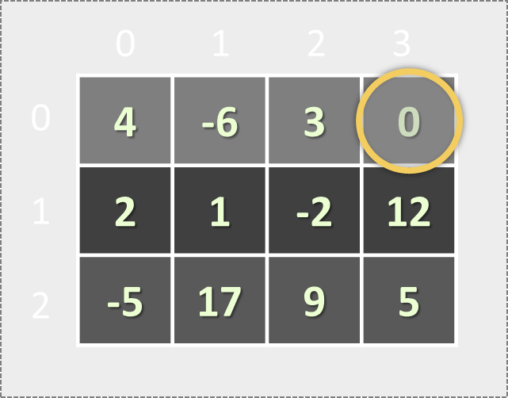
Matrices
Two-Dimensional Arrays

Slide 23
Matrices
A two-dimensional array (a.k.a. matrix) is a table of values
Holds a fixed number of rows, each holding fixed number of columns
Elements are accessed by double indexing: matrix[row, col]
0 1 2 3
0
1
2
4 | -6 | 3 | 0
2 | 1 | -2 | 12
-5 | 17 | 9 | 5
Element matrix[0, 2] at row 0, column 2
Matrix of size 3 x 4
(3 rows x 4 cells)

Slide 24
Problem: Build a Matrix of Letters
Build a matrix of capital Latin letters of size rows x cols like at the examples below:
2
2
A B C D
E F G H
I J K L
M N O P
Q R S T
U V W X
3
7
6
4
A B
C D
A B C D E F G
H I J K L M N
O P Q R S T U
Check your solution here: https://judge.softuni.bg/Contests/Practice/Index/173#6

Slide 25
Solution: Build a Matrix of Letters
Build the matrix of letters of size rows x cols (e.g. 6 rows x 4 cells):
int rows =
int.Parse(Console.ReadLine());
int cols =
int.Parse(Console.ReadLine());
var matrix = new char[rows, cols];
char letter = 'A';
for (int row = 0; row < rows; row++)
for (int col = 0; col < cols; col++)
matrix[row, col] = letter++;
0 1 2 3
0
1
2
3
4
5
A | B | C | D
E | F | G | H
I | J | K | L
M | N | O | P
Q | R | S | T
U | V | W | X
Check your solution here: https://judge.softuni.bg/Contests/Practice/Index/173#6

Slide 26
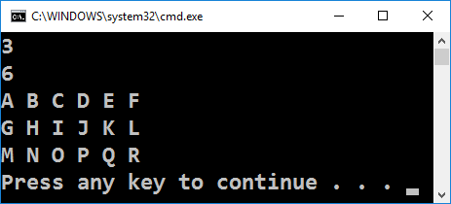
Solution: Print the Matrix
Print the matrix of size rows x cols:
for (int row = 0; row < rows; row++)
{
for (int col = 0; col < cols - 1; col++)
Console.Write(matrix[row, col] + " ");
Console.WriteLine(matrix[row, cols - 1]);
}
Check your solution here: https://judge.softuni.bg/Contests/Practice/Index/173#6

Slide 27
Reading Matrices from the Console
int rows = int.Parse(Console.ReadLine());
int cols = int.Parse(Console.ReadLine());
var matrix = new int[rows, cols];
for (int row = 0; row < rows; row++)
{
var cells = Console.ReadLine()
.Split(' ').Select(int.Parse).ToArray();
for (int col = 0; col < cols; col++)
matrix[row, col] = cells[col];
}

Slide 28
Problem: Rotate a Matrix
Write a program to read a matrix of words (space separated) and rotate it on the right as shown in the examples:
3
4
A B C D
E F G H
I J K L
I E A
J F B
K G C
L H D
3
3
Hi PHP Java
C# SQL JSON
HTML CSS JS
HTML C# Hi
CSS SQL PHP
JS JSON Java
Check your solution here: https://judge.softuni.bg/Contests/Practice/Index/173#7

Slide 29
Solution: Rotate a Matrix
int rows = int.Parse(Console.ReadLine());
int cols = int.Parse(Console.ReadLine());
var matrix = // TODO: read the matrix[,]
// Print the rotated matrix row by row
for (int col = 0; col < cols; col++)
{
for (int row = rows - 1; row >= 0; row--)
Console.Write(matrix[row, col] + " ");
Console.WriteLine();
}
Check your solution here: https://judge.softuni.bg/Contests/Practice/Index/173#7

Slide 30
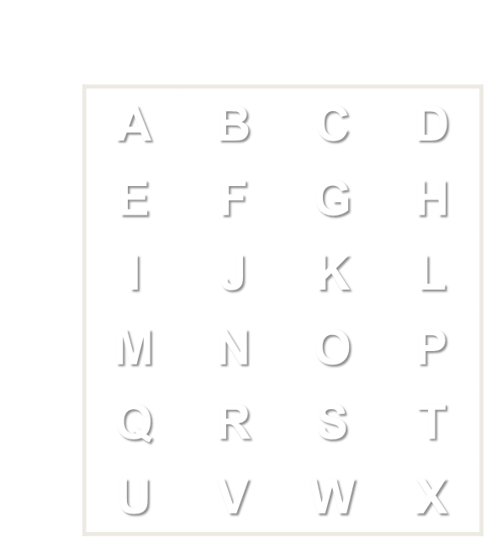
Matrices
Live Exercises in Class (Lab)

Slide 31
Homework: Max Sequence of Equal Elements
Read a list of integers and find the longest sequence of equal elements. If several such exist, print the leftmost. Examples:
Hint: scan positions p from left to right and keep the start and length of the current sequence of equal numbers ending at p
3 4 4 5 5 5 2 2
7 7 4 4 5 5 3 3
1 2 3 3
1 2 3
5 5 5
7 7
3 3
1
Check your solution here: https://judge.softuni.bg/Contests/Practice/Index/173#8

Slide 32
Homework: Matrix of Palindromes
Write a program to generate the following matrix of palindromes of 3 letters with r rows and c columns:
Rows r = 3, Palindromes at each row c = 6.
Both r and c are given at the same line.
4 6
aaa aba aca ada aea afa
bbb bcb bdb beb bfb bgb
ccc cdc cec cfc cgc chc
ddd ded dfd dgd dhd did
Row 0 starts and ends with 'a'.
Row 1 starts and ends with 'b'.
Row 2 starts and ends with 'c'.
…
Check your solution here: https://judge.softuni.bg/Contests/Practice/Index/173#9

Slide 33
Homework: 2 x 2 Squares in Matrix
Find the count of 2 x 2 squares of equal chars in matrix of chars
The matrix size (rows and columns) is given at the first row
Matrix characters come at the next rows lines (space separated)
3 4
A B B D
E B B B
I J B B
3 6
a a d d e f
a a d d r r
m n o p r r
2 2
a b
c d
2
3
0
Check your solution here: https://judge.softuni.bg/Contests/Practice/Index/173#10

Slide 34
Homework: * Largest Increasing Subsequence
Read a list of integers and find the longest increasing subsequence. If several such exist, print, the leftmost. Examples:
Input | Output
1 | 1
7 3 5 8 -1 0 6 7 | 3 5 6 7
1 2 5 3 5 2 4 1 | 1 2 3 5
0 10 20 30 30 40 1 50 2 3 4 5 6 | 0 1 2 3 4 5 6
11 12 13 3 14 4 15 5 6 7 8 7 16 9 8 | 3 4 5 6 7 8 16
Check your solution here: https://judge.softuni.bg/Contests/Practice/Index/173#11

Slide 35
Homework: * Largest Frame in Matrix
Find the largest rectangular frame of same number in matrix of integers. If several equal sized largest frames exist, print all of them, sorted alphabetically:
4 6
2 2 2 2 2 0
2 3 3 2 2 2
2 3 3 2 2 2
2 2 2 2 2 0
3 7
3 5 5 5 3 3 3
3 5 0 5 3 0 3
3 5 5 5 3 3 3
3 6
7 7 0 8 8 8
7 7 0 8 8 8
7 7 7 7 7 7
3x3, 3x3
4x5
1x6, 2x3, 3x2
Check your solution here: https://judge.softuni.bg/Contests/Practice/Index/173#12

Slide 36

Summary
Lists hold resizable arrays of elements
Can add / remove / change elements
Creating a list and adding an element:
Matrices hold a table of elements
Creating a matrix of 3 rows x 10 columns and accessing its elements:
List<int> numbers = new List<int>();
numbers.Add(5);
int[,] matrix = new int[3, 10];
matrix[2, 9] = 100;

Slide 37








Lists and Matrices
https://softuni.bg/courses/programming-basics/

Slide 38
License
This course (slides, examples, demos, videos, homework, etc.) is licensed under the "Creative Commons Attribution-NonCommercial-ShareAlike 4.0 International" license
Attribution: this work may contain portions from
"Fundamentals of Computer Programming with C#" book by Svetlin Nakov & Co. under CC-BY-SA license

Slide 39






Free Trainings @ Software University
Software University Foundation – softuni.org
Software University – High-Quality Education, Profession and Job for Software Developers
softuni.bg
Software University @ Facebook
facebook.com/SoftwareUniversity
Software University @ YouTube
youtube.com/SoftwareUniversity
Software University Forums – forum.softuni.bg

